Slide 1
Earning Call Insights
By: Team 202
Nick Molter
Shan Lin
Tawei Yen
Surya Gundavarapu

Slide 2
Our Goal
We wanted to determine if quarterly earning calls are good predictors of a company’s performance and if they have a significant affect on whether that company is added or dropped from a mutual fund’s holdings

Slide 3
The Structure
Mutual Fund
Q4-Q3
Q3-Q4
List of Companies
Q4
Q3
Added
Dropped
A
B
C
D
E
F
G
A
B
C
D
E
F
G
A
B
C
D
E
F
G
A
B
C
D
E
F
G
Get Earning Calls
Collect Other Financial Data
Natural Language Analysis
Combine Data
Conduct Final Analysis

Slide 4
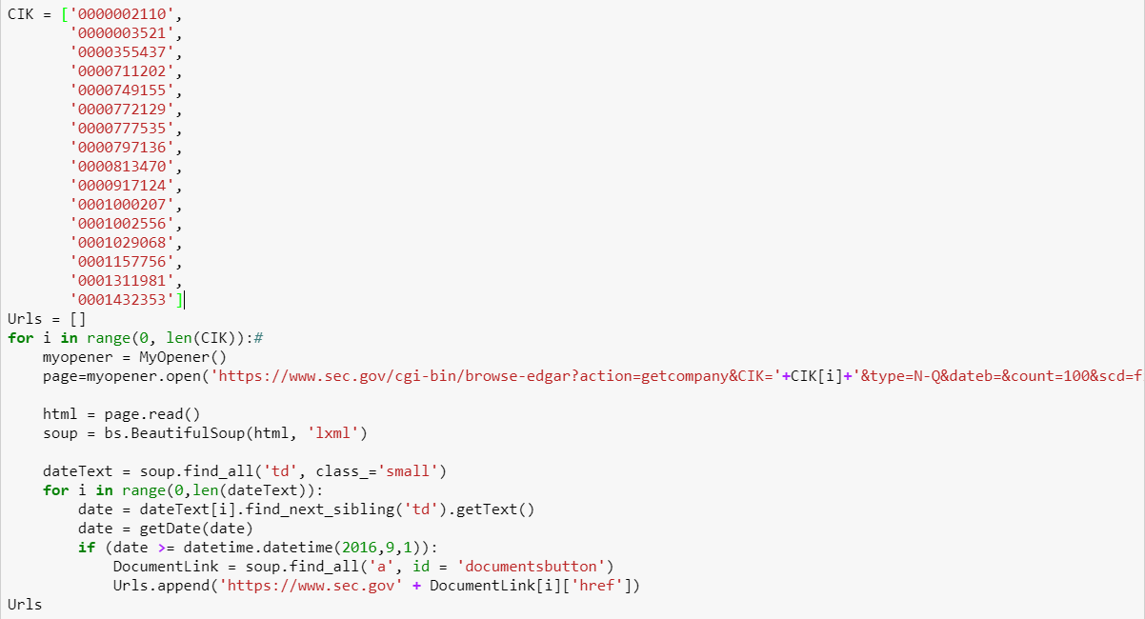
Getting links of mutual fund portfolio
Part1. Scraping Mutual Fund Portfolio

Slide 5
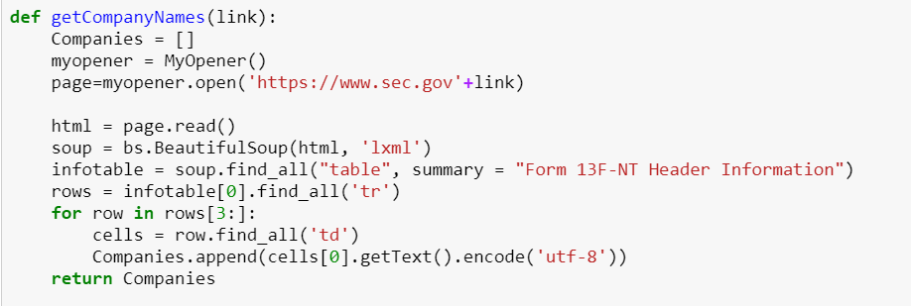
Define function ”getCompanyNames” for scraping mutual fund portfolio
Part1. Scraping Mutual Fund Portfolio

Slide 6
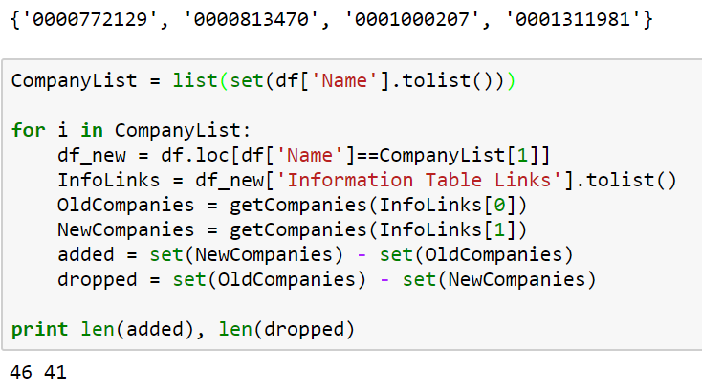
Comparing The Holdings
Part1. Scraping Mutual Fund Portfolio

Slide 7
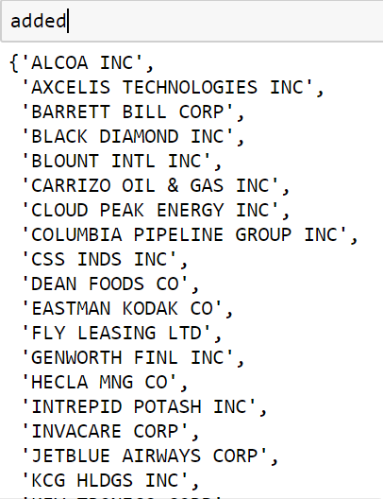
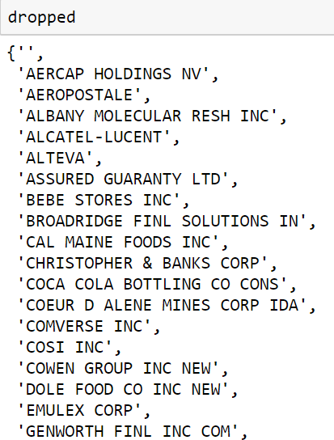
Added and Dropped lists
Part1. Scraping Mutual Fund Portfolio: Result

Slide 8
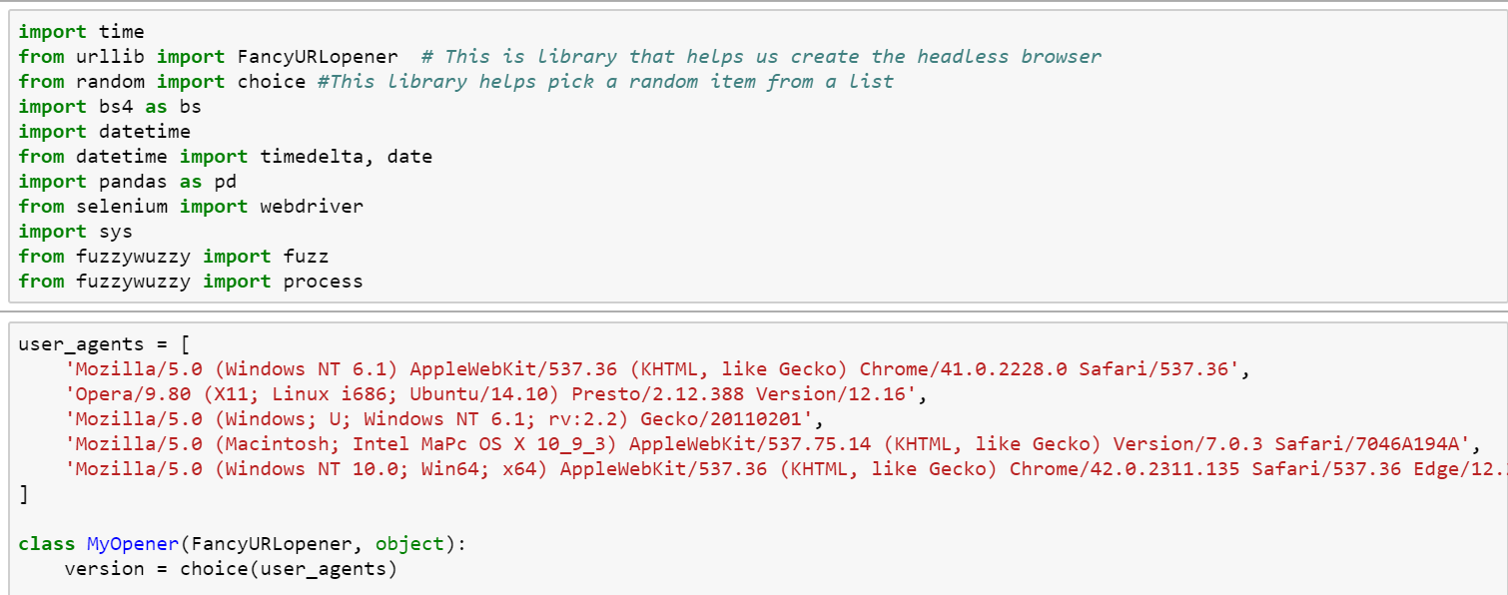
Importing packages and setting headless browsers
Part2. Scraping Earing Call Transcripts

Slide 9
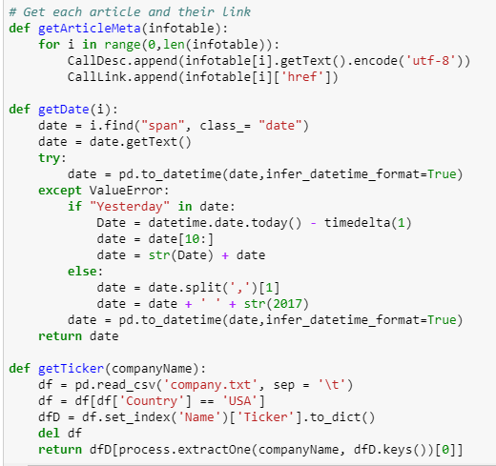
Defining function for getting date and ticker
Part2. Scraping Earing Call Transcripts

Slide 10
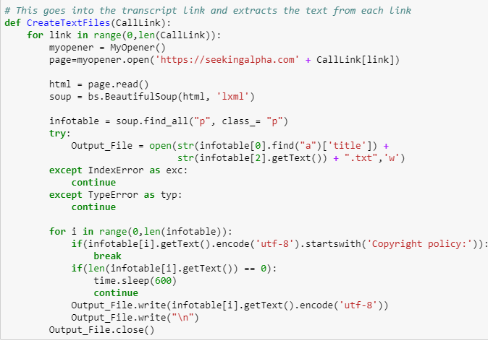
Defining function for scraping transcripts into text files
Part2. Scraping Earing Call Transcripts

Slide 11
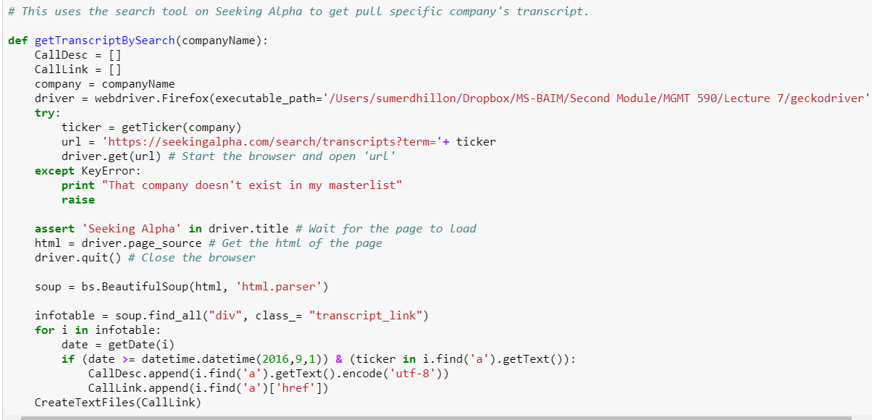
Automatic searching and scraping
Part2. Scraping Earing Call Transcripts

Slide 12
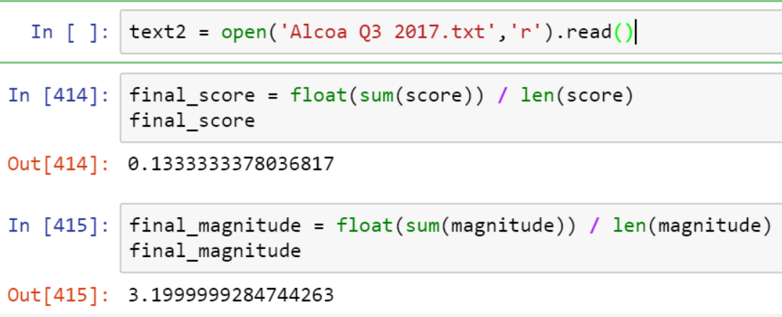
Sentiment Analysis (Google)
Part3. Transcript Analysis
Sentiment Score
Magnitude

Slide 13
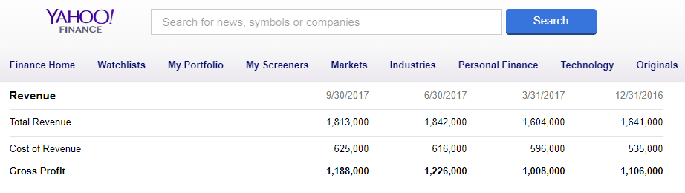
Financial Metrics
Net income – Total earnings
Revenue – Total sales
Total Assets – Book value of all assets
Stock Price – Historical closing price

Slide 14
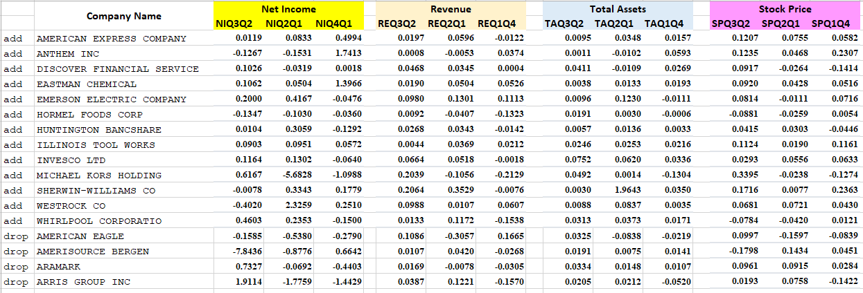
Financial Metrics Data
The metrics are all percentage changes each quarter so they are in the same scale

Slide 15
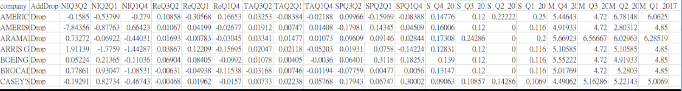
Combining The Data

Slide 16
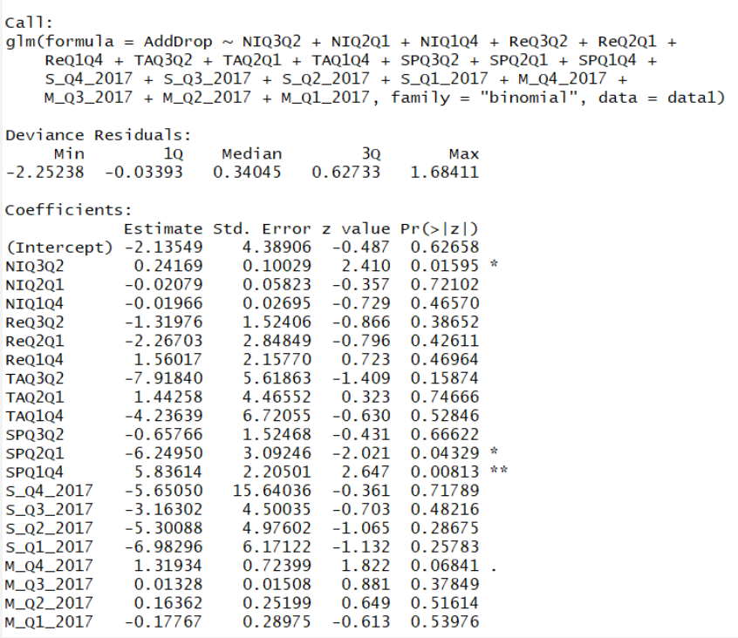
Analysis of The Data

Slide 17
Other Considerations
There are many other factors to consider
Model is limited to only two mutual funds
Expand analysis beyond US firms

